Slide 1
Course Title: Computer Networks Course Code: PCC-CS404 Credit: 3
Presented By
Subhalaxmi Chakraborty

Slide 2
Introduction
Network – Computer Network – Advantages

Slide 3
Network
WHAT?
A group or system of interconnected people or things.
Why?
Connection
Communication
Where?
When we need to transfer anything.

Slide 4
Computer Network
A computer network is a set of devices (often referred to as node) connected by communication links.
A node can be a computer, printer or any other device capable of sending or receiving data generated by other nodes on the network.

Slide 5
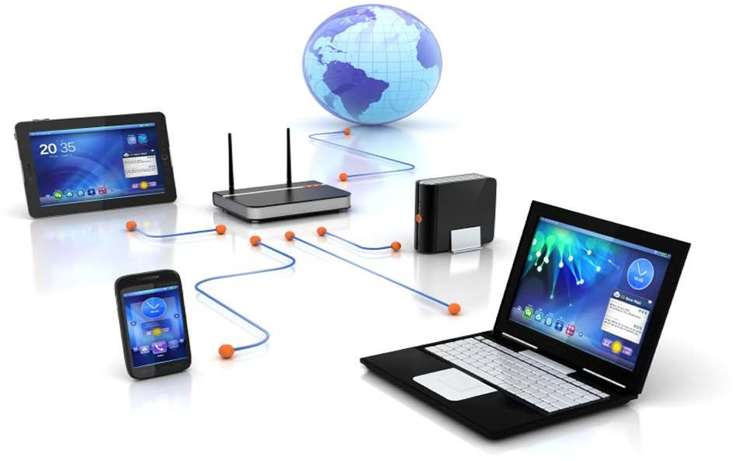
Computer Network

Slide 6
Networking
Networking is a process of communication between two or more remote parties, that involves the connection of computers, media and networking devices.

Slide 7









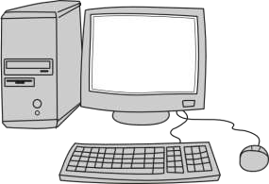
Network Applications
Network
Application

Slide 8
Advantages of Networking
Easy communication
File, data and information sharing
Resource sharing (hardware)
Increase storage capacity
Reduce cost
Save time

Slide 9
The effectiveness of a network communications system depends on four fundamental characteristics:
Delivery- The system must deliver data to the to desired destination. Data must be received by the intended device or user and only by that device or user.
Accuracy-The system must deliver the data accurately. Data that have been altered in transmission and left uncorrected are unusable.

Slide 10
Timeliness-The system must deliver data in a timely manner. Data delivered late are useless. In the case of video and audio, timely delivery means delivering data as they are produced, in the same order that they are produced.
Jitter- Jitter refers to the variation in the packet arrival time. It is the uneven delay in the delivery of audio or video packets. For example, let us assume that video packets are sent every 30 ms. If some of the packets arrive with 30ms delay and others with 40ms delay, an uneven quality in the video is the result

Slide 11
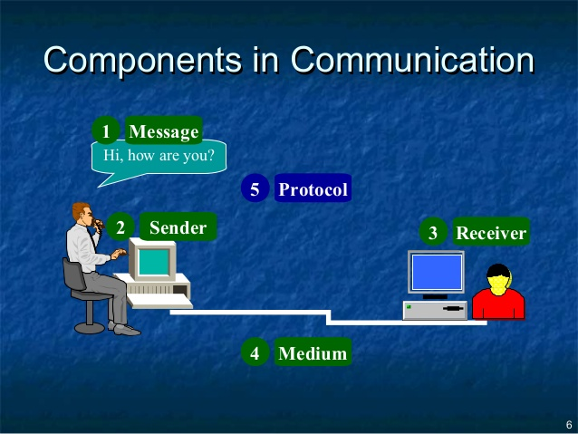

Slide 12
Message- The message is the information (data) to be communicated. Popular forms of information include text, numbers, pictures, audio, and video.
Sender- The sender is the device that sends the data message. It can be a computer, workstation, telephone handset, video camera, and so on.
Receiver- The receiver is the device that receives the message. It can be a computer, workstation, telephone handset, television, and so on.
Transmission medium- The transmission medium is the physical path by which a message travels from sender to receiver. Some examples of transmission media include twisted-pair wire, coaxial cable, fiber-optic cable, and radio waves.
Protocol- A protocol is a set of rules that govern data communications. It represents an agreement between the communicating devices. Without a protocol, two devices may be connected but not communicating, just as a person speaking French cannot be understood by a person who speaks only Japanese.

Slide 13
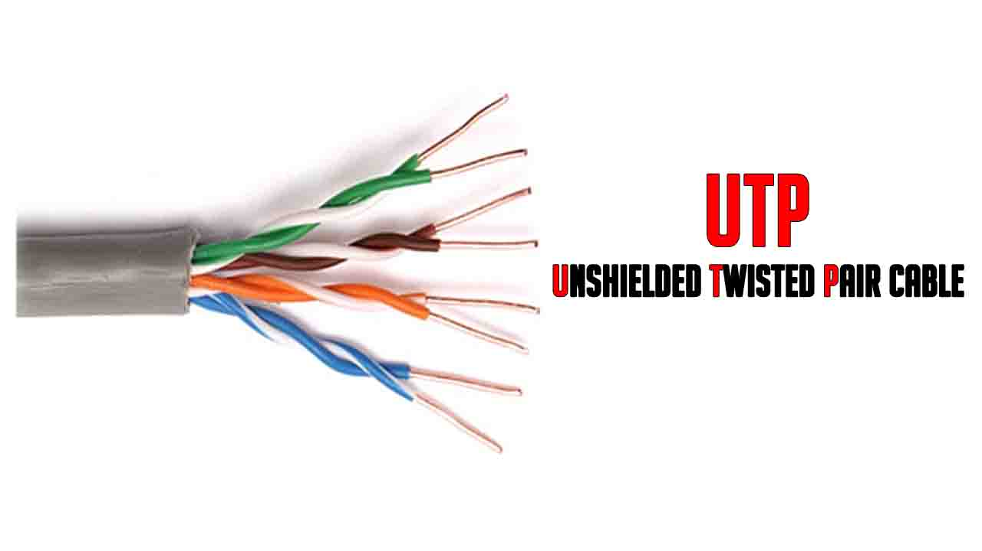
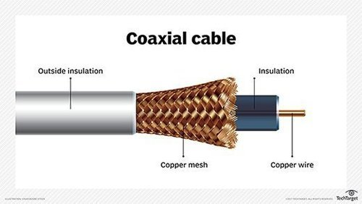
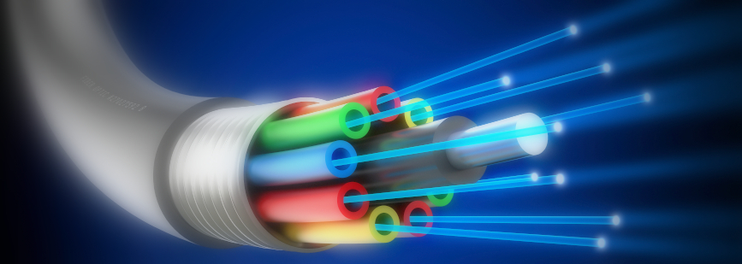

Slide 14
Data Representation
Text- Today, the prevalent coding system is called Unicode, which uses 32 bits to represent a symbol or character used in any language in the world.
Image-
Audio-
Video

Slide 15
QA...
What is the maximum number of characters or symbols that can be represented by Unicode?
A color image uses 16 bits to represent a pixel. What is the maximum number of
different colors that can be represented?

Slide 16
Data Flow
Simplex- the communication is unidirectional
Half-duplex-In half-duplex mode, each station can both transmit and receive, but not at the same time. Example-Walkie-talkies
Full-duplex- In full-duplex both stations can transmit and receive simultaneously. Example- telephonic communication

Slide 17
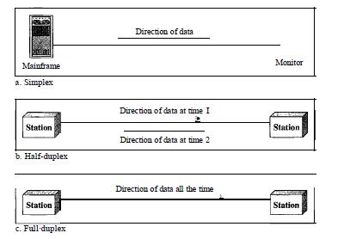
Diagram of three types of data flow

Slide 18
NETWORKS
A network is a set of devices (often referred to as nodes) connected by communication
links.
A node can be a computer, printer, or any other device capable of sending and/or
receiving data generated by other nodes on the network

Slide 19
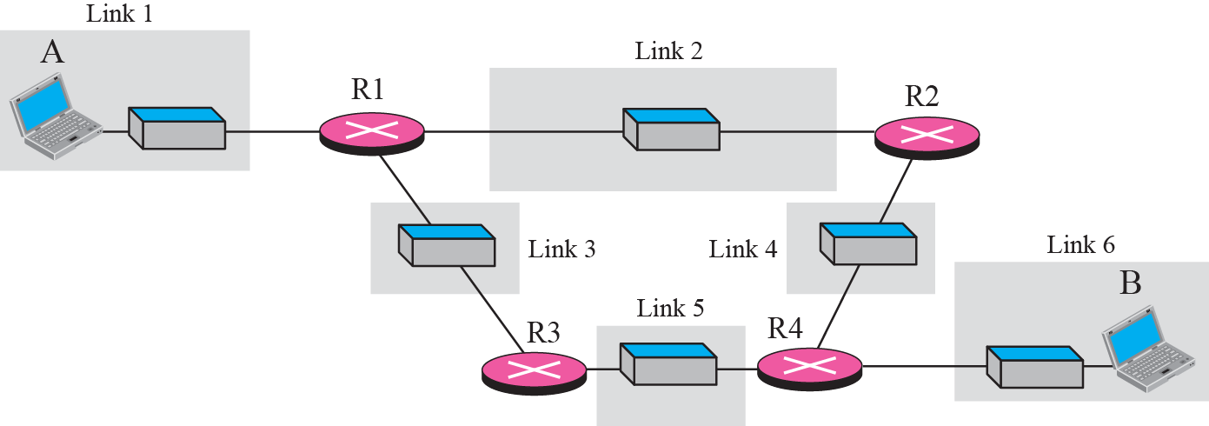
Network

Slide 20
Distributed Processing
Distributed processing- in which a task is divided among multiple computers. Instead of one single large machine being responsible for all aspects of a process, separate computers (usually a personal computer or workstation) handle a subset.

Slide 21
Network Criteria
1. Performance-
-measured in many ways, including transit time and response time.
Transit time is the amount of time required for a message to travel from one device to another.
Response time is the elapsed time between an inquiry and a response.

Slide 22
Network Criteria
2. Reliability-
network reliability is measured by the frequency of failure.
3. Security- issues include protecting data from unauthorized access, protecting data from damage

Slide 23

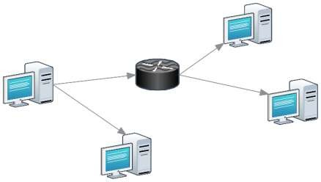
Types of Network
1. Point to Point:
2. Multipoint:

Slide 24
Types of connection
Point-to-Point-
A point-to-point connection provides a dedicated link between two devices.
Example – When you change television channels by infrared remote control, you are establishing a point-to-point connection.

Slide 25
Types of connection
Multipoint –
A multipoint (also called multidrop) connection is one in which more
than two specific devices share a single link

Slide 26
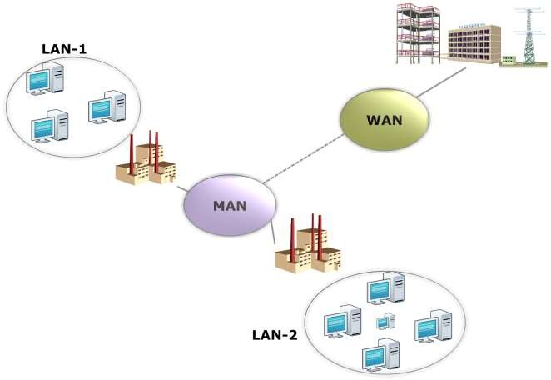
Categories of Network

Slide 27
Categories of Networks
Local Area Network
Software can be stored on this central server and used as needed by the whole group
size of the LAN may be determined by licensing restrictions on the number of users
Wide Area Network
Metropolitan Area Networks

Slide 28
Topology
The term physical topology refers to the way in which a network is laid out physically.:
Two or more devices connect to a link; two or more links form a topology.
Network topology is used initially for planning the best way to design your network to get maximum performance
There are four basic topologies possible:
1.mesh
2. star
3. bus
4. ring

Slide 29
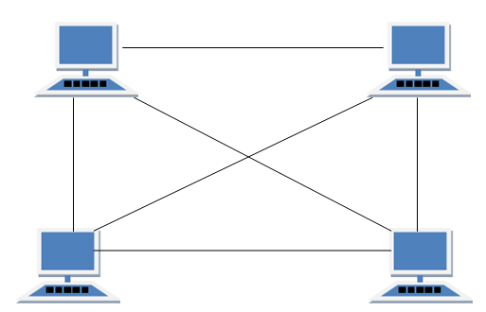
Mesh Topology
Computers in mesh topologies are connected directly to every other device with cables.
Create point to point connection to every device on network.
If one cable fail data always has alternative path to get to its destination.
No. Of links required
=n(n -1) /2

Slide 30
Advantages of Mesh Topology
Each connection can carry its own data load.
It is robust.
Fault is diagnosed easily.
Provides security and privacy.
Disadvantages of Mesh Topology
Installation and configuration is difficult.
Cabling cost is more.
Bulk wiring is required.
mesh topology is
the connection of telephone regional
offices in which each regional office needs to be connected to every other regional office.

Slide 31
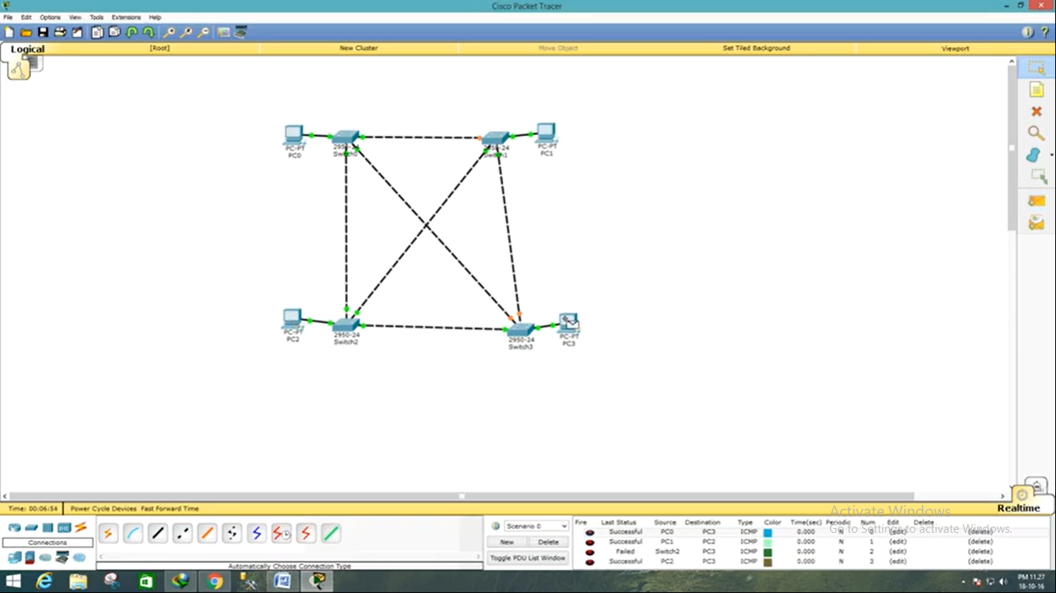
Mesh Topology using CISCO Packet Tracer

Slide 32
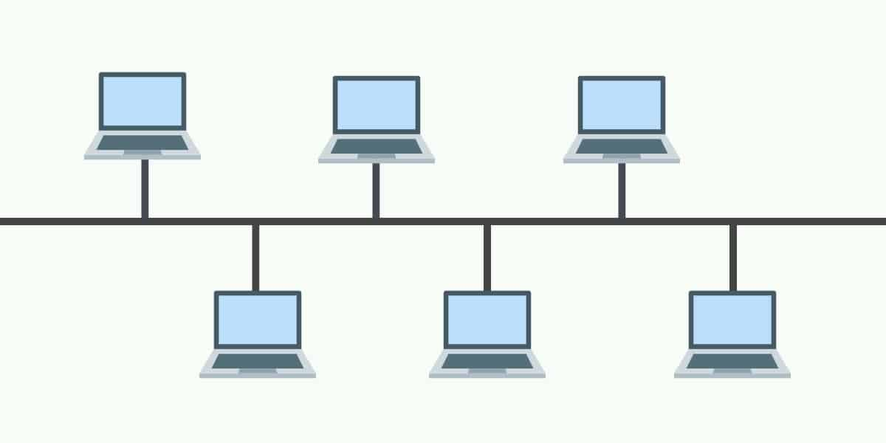
Bus Topology
Bus topology is a network type in which every computer and network device is connected to single cable.
When it has exactly two endpoints, then it is called Linear Bus topology.

Slide 33
Advantages of Bus Topology
It is cost effective.
Cable required is least compared to other network topology.
Used in small networks.
It is easy to understand.
Easy to expand joining two cables together.
Disadvantages of Bus Topology
Cables fails then whole network fails.

Slide 34
RING Topology
It is called ring topology because it forms a ring as each computer is connected to another computer, with the last one connected to the first.
Exactly two neighbours for each device.
The transmission is unidirectional, but it can be made bidirectional by having 2 connections between each Network Node, it is called Dual Ring Topology.

Slide 35
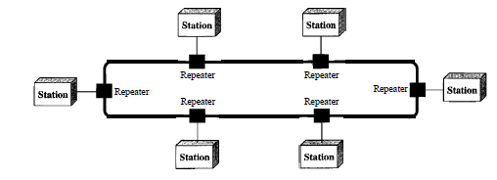
Ring Topology

Slide 36
Advantages of Ring Topology
Transmitting network is not affected by high traffic or by adding more nodes, as only the nodes having tokens can transmit data.
Cheap to install and expand
Disadvantages of Ring Topology
Troubleshooting is difficult in ring topology.
Adding or deleting the computers disturbs the network activity.
Failure of one computer disturbs the whole network.

Slide 37
Star Topology
A star topology is a topology for a Local Area Network (LAN) in which all nodes are individually connected to a central connection point, like a hub or a switch.
A star takes more cable than e.g. a bus, but the benefit is that if a cable fails, only one node will be brought down.

Slide 38
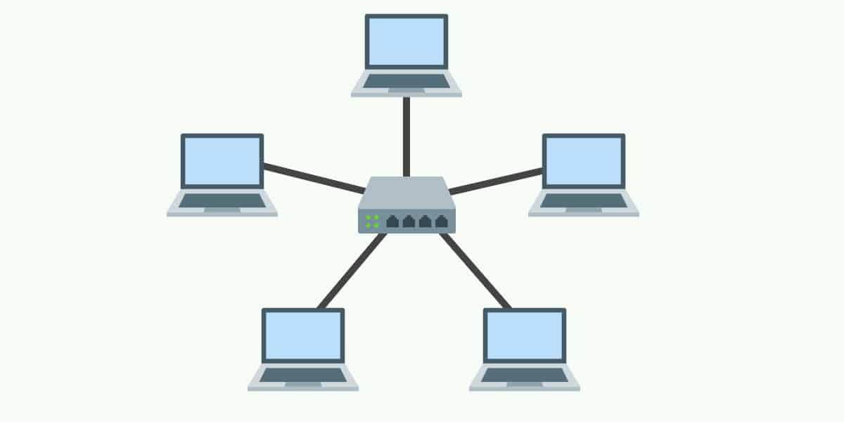
Star Topology

Slide 39
We can divide line configuration in two broad categories:
a. Point-to-point
mesh
star
ring
b. Multipoint
bus

Slide 40
Q A......
Assume six devices are arranged in a mesh topology. How many cables are needed? How many ports are needed for each device?
For n devices in a network, what is the number of cable links required for a mesh, ring, bus, and star topology?

Slide 41
Answer Key
The number of cables for each type of network is:
a. Mesh: n (n – 1) / 2
b. Star: n
c. Ring: n
d. Bus: one backbone and n drop lines

